Slide 1
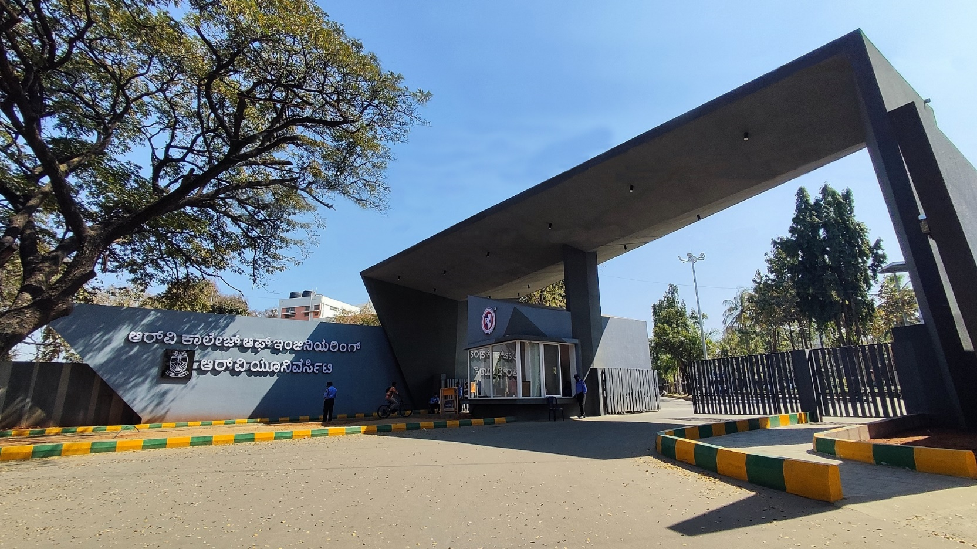
High-Rise Facade Cleaning robot using Vacuum
Adhesion
Manufacturing Process, 39

Slide 2
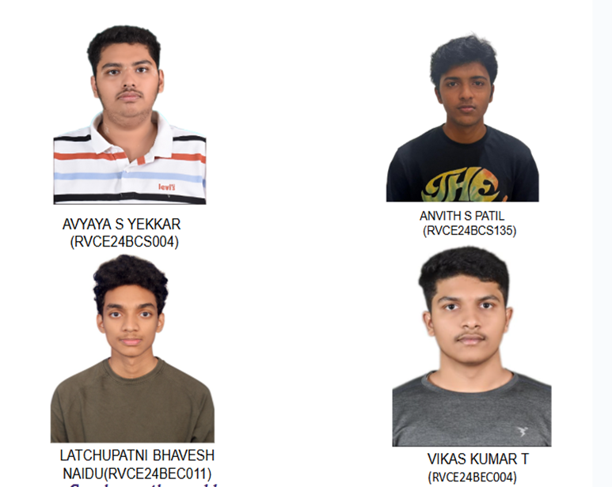

Composition of Team
Prof Manasa M
Assistant Professor
AIML

Slide 3
EL Phase-II
Presentation Outline
Introduction
Project Overview
Comments during EL Phase-I and action taken.
Tools and Techniques Used
Project Progress
Analysis of Partial Results
Deliverables and Outcomes
Future work (Remaining tasks)
Conclusion

Slide 4
Introduction
The project focuses on making a glass cleaning robot which uses suction mechanism for adhesion.
The robot is designed to clean smooth vertical surfaces such as glass etc without human intervention.
This technology addresses the challenges of cleaning in high or hard-to-reach areas, improving safety and accessibility.
By achieving a stable climb and functional cleaning mechanism, it sets the foundation for scaling up, adding autonomous navigation and preparing for real-world deployment in commercial or residential environments, in future.

Slide 5
Project Overview
Manual cleaning of vertical surfaces such as glass facades, or high-rise windows is labor-intensive, time-consuming, and often unsafe. Moreover, there is a lack of compact, low-cost robotic systems capable of stable movement for cleaning purposes.
Primary objective is to design and build a cost-effective, lightweight, and portable robot that can climb glass surfaces using a suction mechanism.
To design and build a cost-effective, lightweight, and portable robot that can climb surfaces using a suction mechanism.

Slide 6
Comments during EL Phase-II and action taken
.Feedback Received (Phase-I):
Change project topic to glass cleaning robot for high-rise buildings.
Use microfiber cloth for better cleaning.
Implement vacuum suction for wall adhesion.
Redesign robot from circular to rectangular shape.
Make the robot wireless.
Renaming the title of the project with technical terms

Slide 7
The project was redefined to focus on a glass cleaning robot for high-rise buildings, employing a vacuum adhesion mechanism for vertical mobility.
A microfibre cleaning pad is going to be integrated to ensure gentle yet effective removal of dust and stains.
BLDC and Propeller were added to provide stable adhesion on vertical glass surfaces.
The robot’s structure was redesigned with a rectangular chassis to enhance surface coverage and directional control.
The system will be upgraded to wireless operation using an ESP32 microcontroller, enabling remote functionality and improved safety.

Slide 8
Tools and Techniques Used
Hardware Components Used
ESP32 Wroom-32 model
N20 DC Motors (6V, 100 RPM)
L298N Motor Drivers (x2)
BLDC Motor (2300 KVA) with 30A ESC
5152 Tri-propeller
SMPS (20A, 12V)
Rubber-Padded Wheels
L2596 Buck Converter
PLA 3D Printed Chassis
Wires, Jumper Cables, Multimeter

Slide 9
Tools and Techniques Used
Software/Techniques Used
Arduino IDE
Serial Monitor
3D CAD Software (SolidWorks)
Rationale for Tool Selection
ESP32: Chosen for its dual-core processing and built-in Wi-Fi/Bluetooth
PLA Material: Lightweight, low-cost, easy to 3D print
BLDC with Propeller: Inspired by drone tech to assist vertical adhesion
L2596: Industry-standard buck converter, efficient for voltage regulation
Rubber wheels: Improve wall traction, minimize slipping

Slide 10
Project Progress
Current Status of the Project:
  The project is currently in the prototype testing phase. We have successfully completed the finalisation of model, procured components and 3D printing of the chassis.
  All core hardware components such as the motors, driver modules, and power supply have been mounted and electrically tested.
  Preliminary functionality tests, including motor operation of wheels and propeller ,have also been conducted.

Slide 11
Project Progress
Milestones achieved thus far and their significance.
Finalised design and successfully 3D printed a lightweight PLA chassis suitable for climbing configurations.
Powered all motors(BLDC and all N20 motor) with appropriate drivers.
Achieved smooth motor control using code and verified BLDC response.
Demonstrated partial adhesion to inclined surfaces, where the robot can remain stationary on inclined walls up to a critical angle using the BLDC-propeller-based suction mechanism.

Slide 12
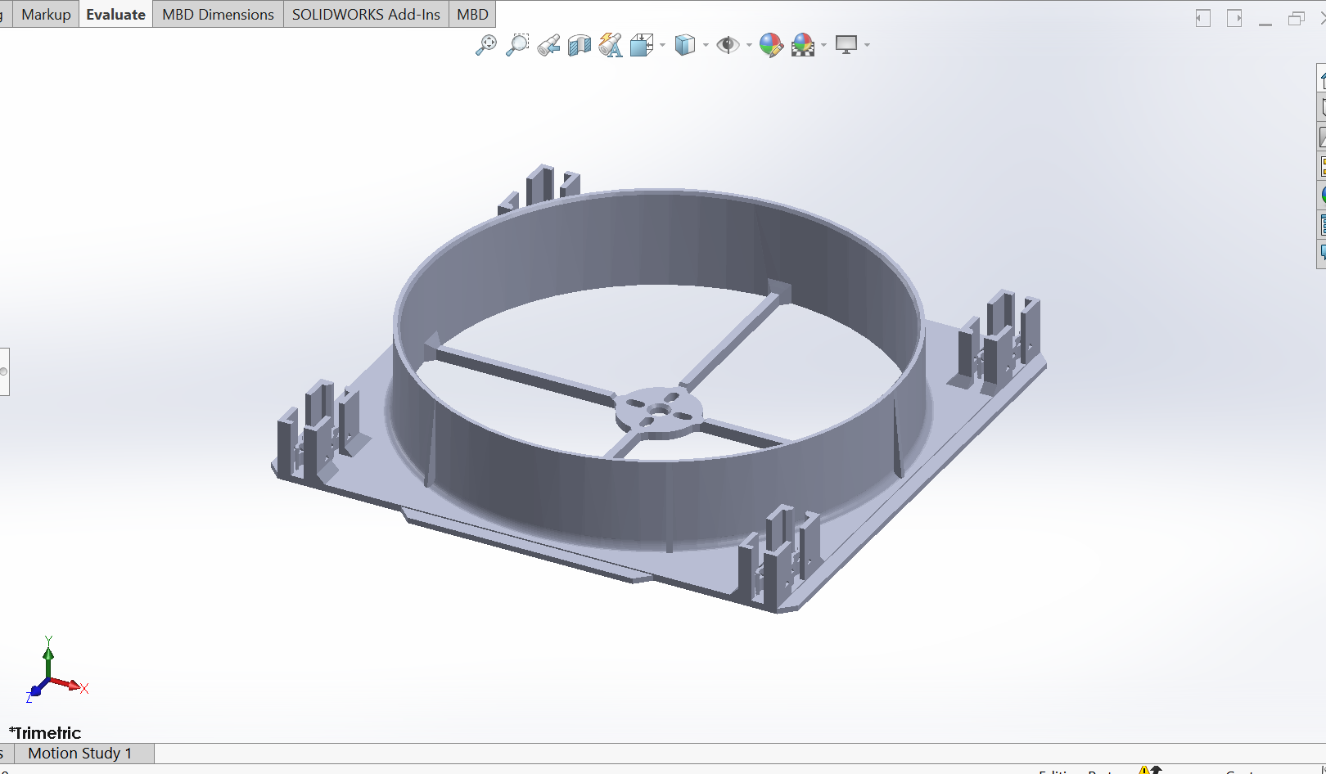
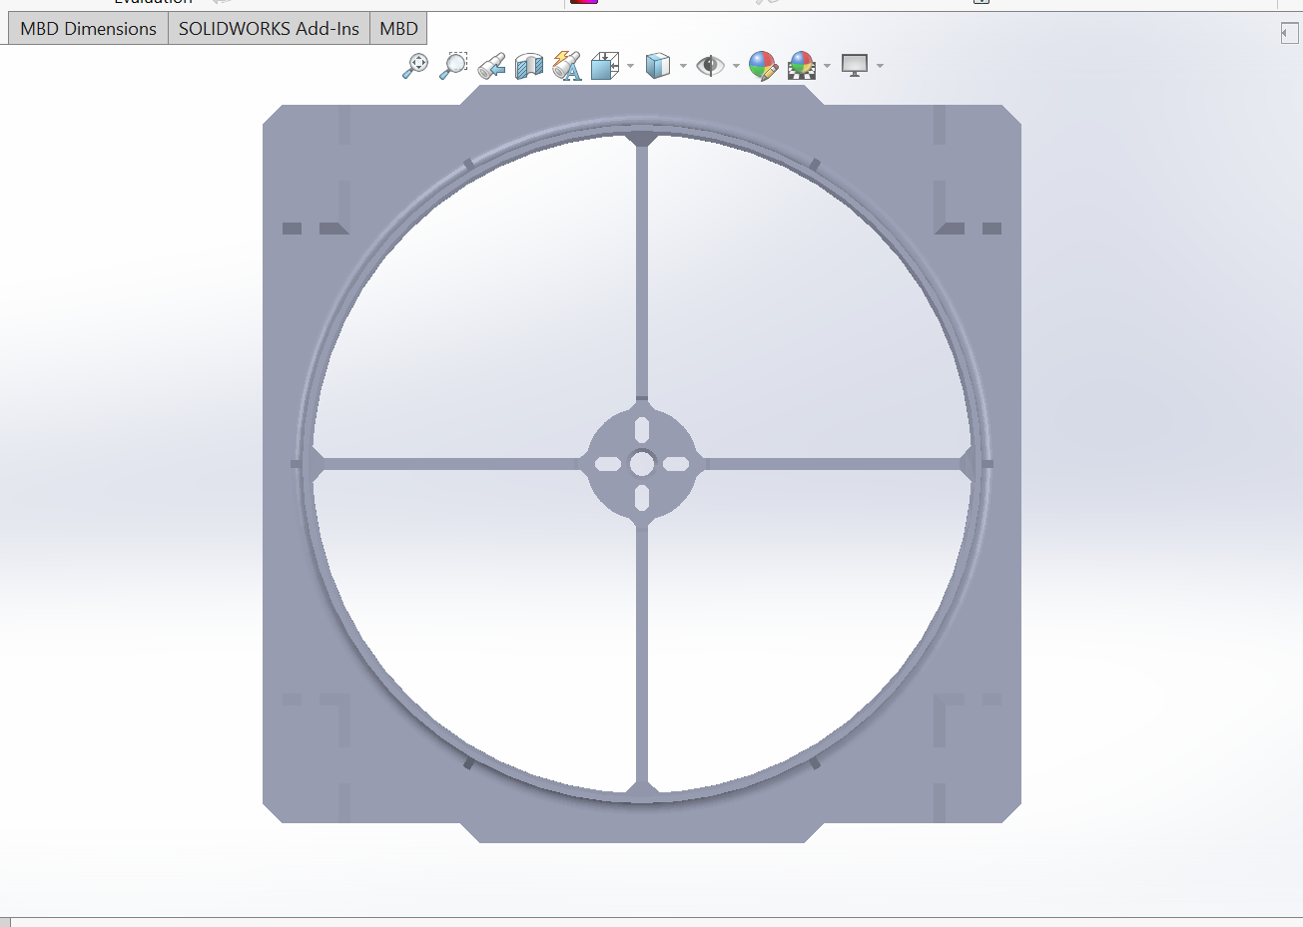
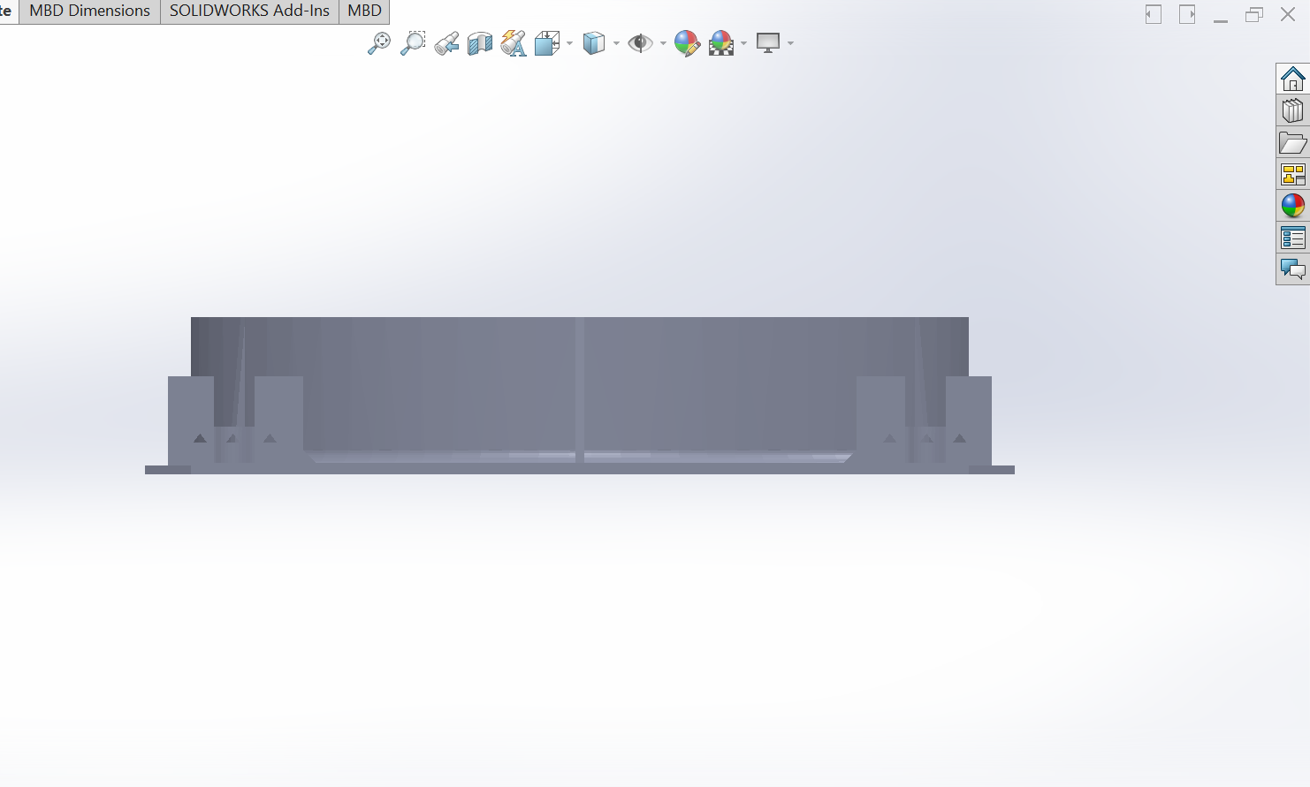
Diameter of suction = 167.687mm
bldc base=27.912mm
bldc base support =64.1mm
bldc base hole =6mm
height of suction hole =31.99mm
width of robot =56.102
distance between robot and suction hole =6.85mm
length of the robot=180mm
thickness of hole= 1.32mm
cleaning area =12008.59 mm
thickness =5.5mm

Slide 13
Calculations
4 × N20 (100 RPM, 0.0686 Nm rated torque) motors are used
1 RS2205 2300KV BLDC + 5152 propeller
12V 20A SMPS power supply
Wheel diameter = 44 mm
Approx max Robot total weight= 700g = 0.7 kg
Reference Paper: https://www.jetir.org/papers/JETIR2304892.pdf

Slide 14
Calculations
Forces Acting on the Robot
1.Weight of Robot
Fgravity=m⋅g=0.7⋅9.81=6.867 N
2. Normal Force (Suction force from BLDC)
To hold robot against vertical wall, the BLDC thrust must match the weight:
Fnormal=6.867 N
3. Friction Force (due to suction)
Assumption: Coefficient of friction between wheels and glass: μ = 0.4
Ffriction=μ x Fnormal=0.4 x 6.867= 2.748N

Slide 15
Calculations
Total Force the Wheels Must Overcome:
Ftotal​ = Fgravity ​+ Ffriction ​= 6.867+2.748 = 9.615N
Torque Required per Wheel:
Fwheel​=Ftotal/4​​=9.615/4​=2.403N​
Trequired per wheel ​= Fwheel​⋅r = 2.403* 0.022=0.0528Nm
N20 Motor Torque Rating: 0.0686Nm

Slide 16
Challenges Faced and Solutions
N20 Motors(6V) compatibility with SMPS(12V): Used Buck Converter to step down 12V to 6V.
BLDC compatibility with esp-32 and Arduino.
COM5 error: Technical issue in the Arduino IDE.
The motor didn’t fit properly due to dimensional mismatch and misalignment
L298N burning due to overvoltage during testing.
Asyncronization of wheels

Slide 17
Analysis of Partial Results
Prototype Assembly and Testing
The prototype was physically assembled using a 3D-printed chassis.
Core components — 4 × N20 6V 60RPM motors, dual L298N motor drivers, RS2205 2300KV BLDC motor, and a 30A ESC — were installed and wired.
Power delivery was handled using a 12V 20A SMPS connected to 2 LM2596 buck converters (set to 6V for N20 motors and 5V for ESP32 control).

Slide 18
Analysis of Partial Results
Experimental Outcomes
Motor tests (no wheels): All N20 motors spun consistently in forward and reverse when powered and controlled via L298N drivers.
BLDC + ESC tests: The BLDC motor responded to PWM signals, producing proper rotation after ESC initialization. Pitch/beep variations confirmed valid signal reception.
Inclination test: The prototype was placed on a surface inclined between 45° to 60°. With only motor torque, it maintained grip and could move partially upward, suggesting good low-RPM torque from the N20 motors.

Slide 19
Analysis of Partial Results
Power response: Motor vibration without movement (seen in early AA battery tests) was resolved by switching to regulated SMPS + buck converter power.

Slide 20
Deliverables and Outcomes
Key Deliverables:
    3D-Printed Chassis: A lightweight, compact, and modular chassis was successfully 3D printed.
    Assembled Physical Prototype:All major hardware components were mounted and connected
    Power System Integration:A safe, stable power delivery setup was implemented using the SMPS and buck converters to power different voltage domains(12V, 6V).
    Motor Testing Code & PWM ESC Control
    Inclined Surface Testing: Reliable response observed from all components.

Slide 21
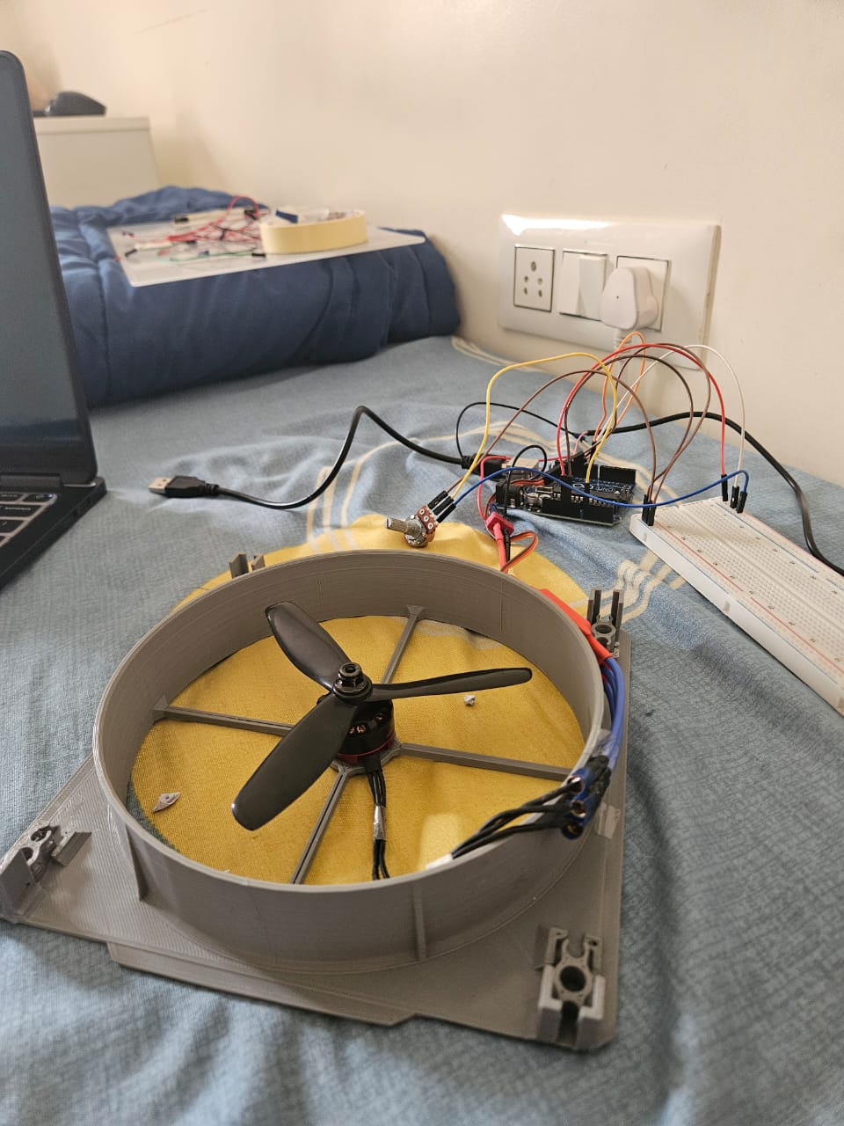
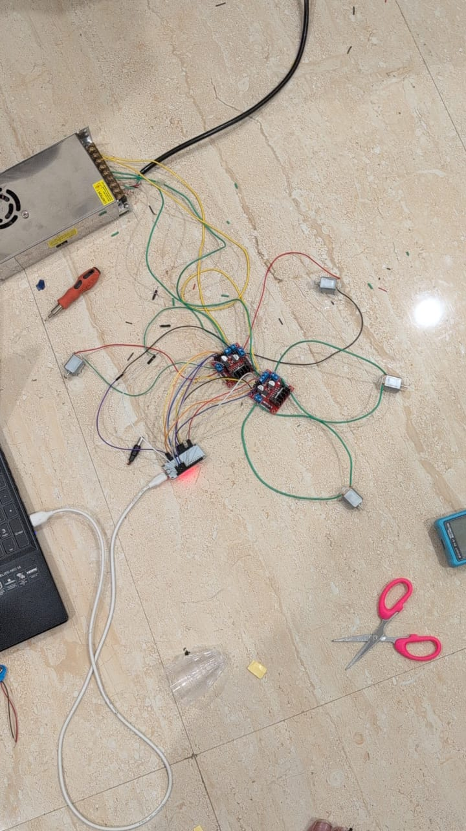
Deliverables and Outcomes
Visual Documentation:
1) 3d printed chassis: 2)4 X N20 motors Working circuit

Slide 22
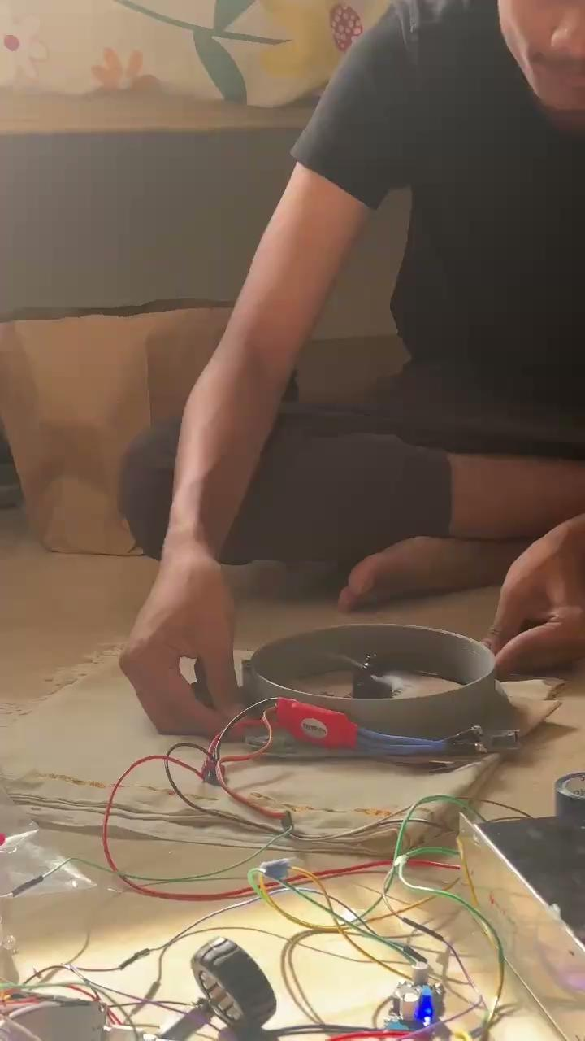
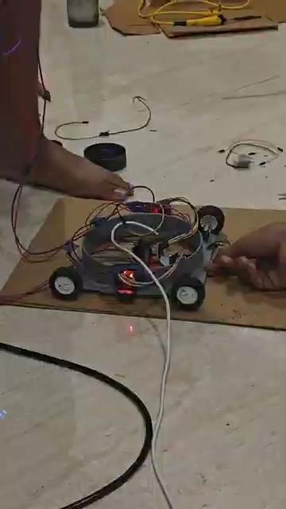
Deliverables and Outcomes
Visual Documentation:
3)Testing of BLDC Motor on paper 4) Testing N20 motors

Slide 23
Future Work (Remaining Tasks)
Integration of BLDC and N20 Motors
The current prototype features both types of motors independently. However, their combined integration and synchronized operation is yet to be achieved. This will ensure that the robot can move and clean effectively across both vertical and horizontal surfaces using microfibres
Testing in Vertical (90°) Orientation
While the robot functions successfully on flat and inclined surfaces, it has not yet been tested at a full 90° vertical angle, which is essential for high-rise glass facade cleaning. This test will confirm the reliability of the vacuum adhesion system and the robot’s overall mechanical integrity.

Slide 24
Future Work (Remaining Tasks)
Motor Driver and Control Optimization
The BLDC and N20 motors operate on different control principles. Fine-tuning the motor driver logic and speed synchronization is necessary to prevent drift or imbalance during operation.

Slide 25
Conclusion
The project has successfully progressed from design to a fully assembled prototype. Core components such as the 3D-printed chassis, motor drivers, N20 motors, and BLDC propulsion system were tested.
Power stability, motor responsiveness, and structural durability have all been validated. These outcomes confirm that the system is capable of basic movement and incline handling, forming a solid foundation for the next development phase-integrating suction or lift mechanisms for vertical surface operation.
The results so far strongly support the feasibility and future potential of the robot in real-life applications such as glass cleaning.

Slide 26


